Slide 1

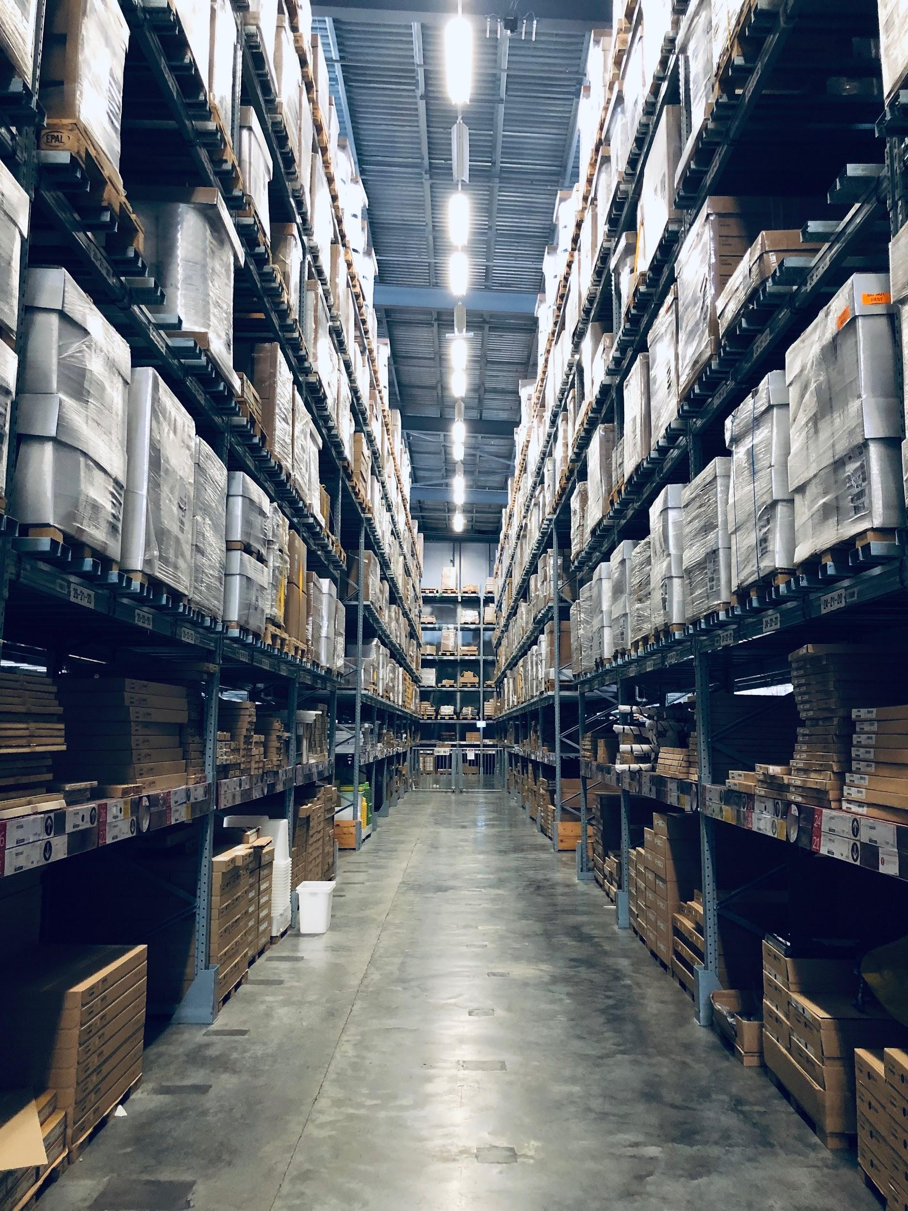



Why should LEAR consider Flowlity to respond to raw materials and components shortages ? Frank Wachowiak
June 7th, 2022

Slide 2
Context and Objectives
Why should LEAR seriously consider Flowlity?
Why did St Gobain Sekurit, Bosh and Lisi choose us?
How can we improve the performance of your SAP IBP suite?
What is our Value proposition for LEAR?

Slide 3

1. Why should LEAR seriously consider Flowlity?
1. Flowlity enhances your ERP / Helps solving volatility :
Flowlity specializes in delivering a Unique Supply Chain approach that enhances / complements the usual MRP driven safety stocks approach to achieve further inventory reduction and reduce risk of shortages with the same level of service, even in a congested Supply Chain situation.
2. Flowlity has proven automotive experience at Bosh, Saint Gobain and Lisi
3. What are the Benefits of this approach for LEAR?
Significant Inventory reduction or shortages reduction of 20% to 30% translating into significant savings
Mastered volatility (Market, demand, supply difficulties, component shortages and changing delivery times, …)
Reduced impacts of raw materials and components shortages
Improved End-to-end planning including Supplier network for more reliability
Lead time control, more accurate forecasts, improved ordering …

Slide 4


2. Why did St Gobain Sekurit, Lisi choose Flowlity?
St Gobain SEKURIT Challenges :
minimizing the stock level and
increasing the availability of components.
Benefits using Flowlity
Reduction of the overall stock level of 40% for items under own management and those managed in consignment
Consignment suppliers saw their average inventory level decrease. It was then easy for them to accept to follow the requests of our client to increase the safety stock in risky periods, thus ensuring a reduction of shortages.
Accuracy of consumption forecasts has also significantly increased.
More reliable replenishment plans communicated to suppliers
Lisi Business challenge
Lack of ability to maintain adequate stock levels to meet volatile demand from internal customers causing low service rate.
Benefits
Improved visibility and smoothing of medium term demand (2-3 months).
Optimized stock performance across the supply chain.
Ability to Manage uncertainty with forecast confidence intervals
Better demand visibility.
Less stock-outs.
Lower inventory levels

Slide 5

2. Why did BOSCH choose Flowlity?
Project objectives
Optimize inventory with a focus on reducing inventory and scrap
Improve user workflow / digitize the planning process
Project scope (Full integration with SAP)
Consumption history data comes from SAP
Consumption forecast is calculated in Flowlity
Order proposals are calculated in Flowlity respecting supply constraints
Stock Min / Max in Flowlity : Stock buffer ensuring optimal planning
Stock Projections and replenishment are calculated by Flowlity
Benefits
Reduced Inventorie
Lesser scrap
Improved demand visibility AND user workflow
Faster decision making
Improved stock projection with a blink of an eye

Slide 6
3. How can LEAR improve the performance of your SAP IBP suite with Flowlity?
By Integrating Flowlity with SAP IBP LEAR will turn its SC into a resilient one meaning :
Greater capacity to resist and quickly recover for unexpected events resulting in Reduced impacts due to shortages of raw materials and components
Faster reaction to lead time changes and safer replenishment plans
HOW is this made possible?
We dynamically define Optimal Sock Buffers taking into account : demand volumes, demand volatility, lead times, supply constraints, historical consumption behavior, targeted service levels, targeted service levels.
The Innovative Flowlity IA technology enables customers to establish new scenarios and prevent new crisis with ever greater precision and limit the differences between the forecast and reality.
With Flowlity Safety Stocks are not fixed anymore but Dynamic (adjustments are made based on risks of demand and supplies)
Lead times are not fixed anymore but Predicted (based on historical performance)
SAP IBP Performance is improved by regularly adjusting inventory recommendations and providing continuously major forecasts, replenishments and ordering improvements

Slide 7
4. Our value proposition to LEAR & Next steps
Our value proposition for LEAR
We can greatly improve the performances of your SAP IBP installation
We will help LEAR reduce raw materials and components shortages while maintaining service levels even in a congested situation like we did for Bosch, Lisi and Saint-Gobain Sekurit
Next proposed steps:
Better discover / understand the challenges of LEAR with regards to shortages
Showcase the relevent references to show how we respond to the same pains at other automotive customers

Slide 8


Thank you for considering Flowlity as a partner moving forward

